Slide 1
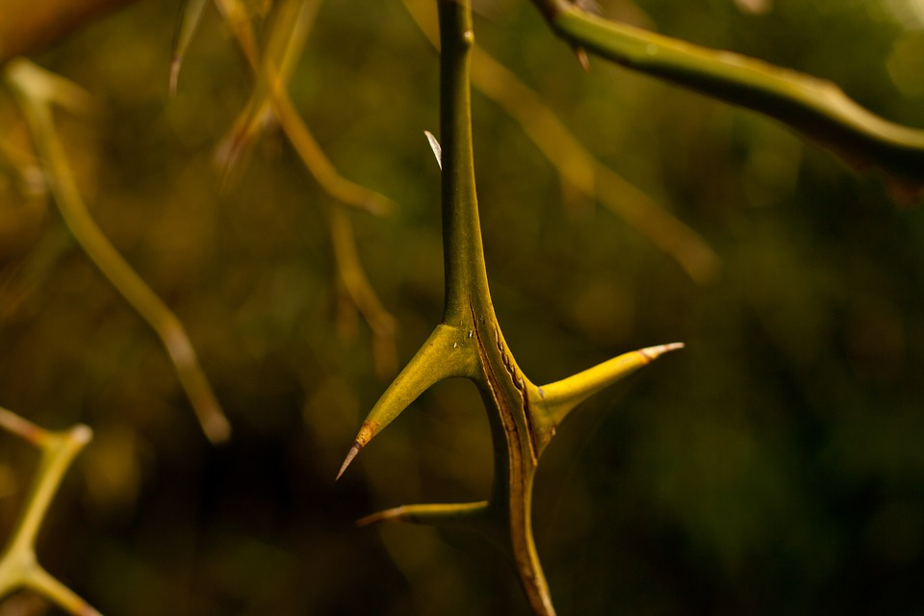
“The Nature of Sin”
a study of Genesis 3 for evangelism
part two:
Genesis
3:14-24

Slide 2
The Nature of Sin
(part two)
Genesis 3:14-15
“...God said to the serpent: ‛Because you have done this...’” [v14]
⬧ While God allowed the man and the woman to answer for their actions
(even though they didn’t answer well ), He goes straight to the serpent’s
punishment, allowing no defense
- The book of Genesis emphasizes the difference between man and the rest
of creation – God gives a place of special honor to human beings, offering
us opportunity for repentance and forgiveness...
Genesis 3

Slide 3
The Nature of Sin
(part two)
Genesis 3:14-15
“...God said to the serpent: ‛Because you have done this...’” [v14]
⬧ While God allowed the man and the woman to answer for their actions
(even though they didn’t answer well ), He goes straight to the serpent’s
punishment, allowing no defense
⬧ “...you are cursed more than all cattle...” [v14]
- God cursed one of His creatures because it used its capacity for intelligence to
lead others into evil:
This curse has three aspects:
(1) crawl on its belly. From its exalted position [a serpent that
speaks and walks (or flies)!] to a posture of humiliation [v14];
(2) eat dust all its life. Dust is carnal, earthly. It would no longer
eat of the green and living herb [1:30]: its days would end [v14];
(3) enmity with the woman's “Seed” [v15]
Genesis 3

Slide 4
The Nature of Sin
(part two)
“enmity between you and the woman…”
More than fear of snakes, God states the end from the beginning:
What we see in Genesis 3:15 is a ray of hope at the exact moment it appears
that all hope is gone...
This “enmity” will bring to the serpent:
- the woman’s aversion; the “friendship” that made Eve trust the serpent instead
of God is over; now the serpent will need to be even more clever in the future!
- a war that will last for generations; in the end, the serpent will taste defeat by the
woman’s descendant
This is the first Messianic prophecy; the Christ, who will come only of a woman (a virgin, daughter of Eve!), will hurt only His heel as He mortally stomps the head of His ancient enemy! With those words, God announces His plan to save man: a plan that He prepared even before He made the universe!
[cp 1 Cor 2:7; Eph 1:3-4; 1 Pet 1:19-20; Rev 13:8; etc]
Genesis 3

Slide 5
The Nature of Sin
(part two)
Genesis 3:16
“To the woman He said...”
⬧ After hearing the woman's “confession” and ordering the serpent’s
punishment, God decrees the woman's sentence:
Her sentence has two aspects:
(1) pain tied to the reproductive process. The promise of a descendant to stomp the head of the serpent will require a painful sacrifice from the woman – one which will be even more painful for God, who will deliver His own Son up to death!
(2) submission to her husband's rule. She was created as his “helper”; to restore order after sin (she gave him the fruit!), she will have to accept and fulfill her role well. [Perhaps this has more to do with man's weakness than with woman's; “Adam was not deceived” (but he ate when she offered the fruit!); cp 1 Tm 2:14-15]
Genesis 3

Slide 6
The Nature of Sin
(part two)
Genesis 3:17-19
“Then to Adam He said...” [v17]
⬧ After delivering the sentences to the serpent and to the woman, God
deals with Adam's sin:
Adam's problem was that he listened to the voice of his wife
when God had already given clear instruction on the matter:
- When a wife offers “help” so that the man may better fulfill the word
of God, her husband certainly should heed her voice! However, if his
wife or anyone else offers advice that goes against what God clearly
has stated, their voice must not be heeded by any means! [cp Gn 16:2]
Genesis 3

Slide 7
The Nature of Sin
(part two)
Genesis 3:17-19
“Then to Adam He said...” [v17]
⬧ After delivering the sentences to the serpent and to the woman, God
deals with Adam's sin: “cursed is the ground for your sake...” [v17]
Because of Adam's sin, God cursed the ground (the earth itself!), which then brought consequences on all of creation:
Genesis 3

Slide 8
The Nature of Sin
(part two)
Guilt or Consequence?
Does the Bible teach that we are born guilty in sin
(so-called “original sin”) because of Adam?
What we can observe about this in Genesis 3:
- God pronounced punishment individually for each person
who was guilty of sin [the serpent (3:14-15), woman (3:16),
& man (3:17-19)].
• If all are guilty because of Adam’s sin, then why are the serpent
and the woman punished, if they sinned before Adam did?
- The curse which God pronounced on the earth because Adam
sinned brought consequences to all of creation, including
physical death; however, guilt for sin is only imputed to the
one who actually sinned! [cp Ezekiel 18:4, 20; etc]
Genesis 3

Slide 9
The Nature of Sin
(part two)
Genesis 3:17-19
“Then to Adam He said...” [v17]
⬧ After delivering the sentences to the serpent and to the woman, God
deals with Adam's sin: “cursed is the ground for your sake...” [v17]
Because of Adam's sin, God cursed the ground (the earth itself!), which then brought consequences on all of creation:
-“in toil you shall eat of it...”; this is the same phrase translated as
“in pain” for the woman in Gen 3:16. The punishment is the same
but is specifically related to the role that each one must fulfill...
Genesis 3

Slide 10
The Nature of Sin
(part two)
Genesis 3:17-19
“Then to Adam He said...” [v17]
⬧ After delivering the sentences to the serpent and to the woman, God
deals with Adam's sin: “cursed is the ground for your sake...” [v17]
Because of Adam's sin, God cursed the ground (the earth itself!), which then brought consequences on all of creation:
all the days of your life...”; God said from
the beginning that in the day they should eat of this tree, they would
“surely die”; their days now will be counted and come to an end...
-“in toil you shall eat of it
Genesis 3

Slide 11
The Nature of Sin
(part two)
Genesis 3:17-19
“Then to Adam He said...” [v17]
⬧ After delivering the sentences to the serpent and to the woman, God
deals with Adam's sin: “cursed is the ground for your sake...” [v17]
Because of Adam's sin, God cursed the ground (the earth itself!), which then brought consequences on all of creation:
all the days of your life...” [v17]
-“in toil you shall eat of it
-“Both thorns and thistles it shall bring forth...”; one of the ways
the curse would manifest itself would be the production of thorny
growth where before there was only the beauty of green herbs and
fruited plants and trees...
Genesis 3

Slide 12
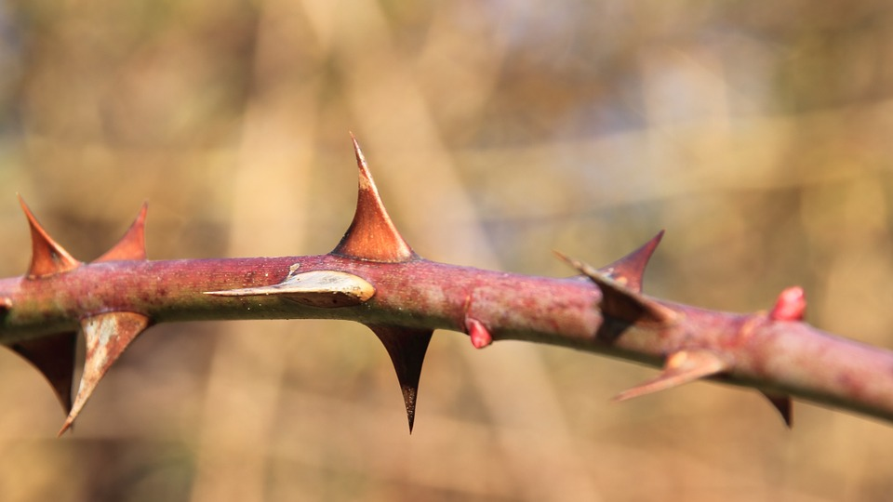
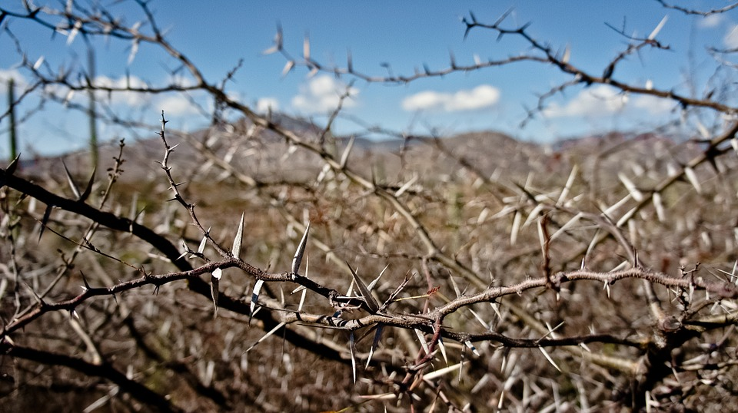
The Nature of Sin
(part two)
“thorns and thistles it shall bring forth…”
A symbol of God’s curse on the Earth, thorns
call to mind the sadness of sin all throughout the Bible:
- Genesis 3:18: the Earth produces thorns,
making man’s toil difficult
- Isaiah 34:13: “And thorns shall come up in its palaces,
nettles and brambles in its fortresses...”
- Hosea 9:6: “...nettles shall possess their valuables of
silver; thorns shall be in their tents.”
- 2 Cor 12:7: the apostle Paul speaks of a “thorn in the
flesh...a messenger of Satan to buffet me,
lest I be exalted above measure.”
Genesis 3

Slide 13
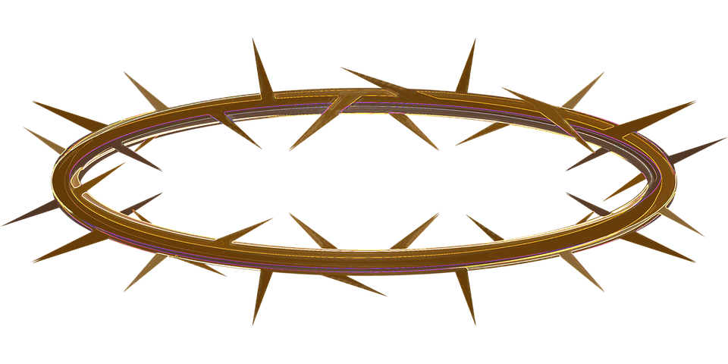
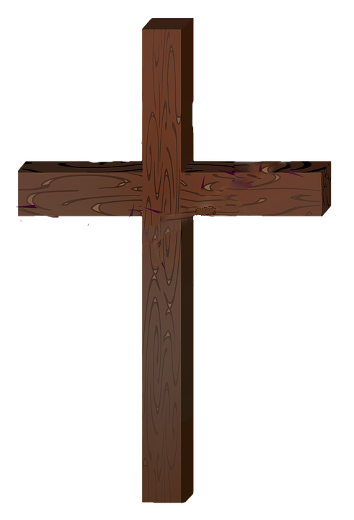
The Nature of Sin
(part two)
“thorns and thistles it shall bring forth…”
A symbol of God’s curse on the Earth, thorns
call to mind the sadness of sin all throughout the Bible:
One image of thorns is more deeply moving than the others...
“Surely He has borne our griefs and carried our sorrows...”
[Isaiah 53:4]
“...who Himself bore our sins in His own body on the tree... by whose stripes you were healed.” [1 Peter 2:24]
“And they clothed Him with purple; and they twisted a crown of thorns, put it on his head.” [Mark 15:17]
Who placed this crown of thorns, the ultimate biblical symbol for sin, upon the head of the one who bore the sins of the world?
Roman soldiers, who knew nothing of the Bible or its symbolism!
Genesis 3

Slide 14
The Nature of Sin
(part two)
Genesis 3:17-19
“Then to Adam He said...” [v17]
⬧ After delivering the sentences to the serpent and to the woman, God
deals with Adam's sin: “cursed is the ground for your sake...” [v17]
Because of Adam's sin, God cursed the ground (the earth itself!), which then brought consequences on all of creation:
all the days of your life...” [v17]
-“in toil you shall eat of it
-“Both thorns and thistles it shall bring forth...” [v18]
-“In the sweat of your face you shall eat bread...”; because of the
thorns, the man’s work which had been just “to tend and keep” the
Garden [2:15] would now be much more “toilsome”. He must now
till, weed, plant, tend, cultivate and harvest...
Genesis 3

Slide 15
The Nature of Sin
(part two)
Genesis 3:17-19
“Then to Adam He said...” [v17]
⬧ After delivering the sentences to the serpent and to the woman, God
deals with Adam's sin: “cursed is the ground for your sake...” [v17]
Because of Adam's sin, God cursed the ground (the earth itself!), which then brought consequences on all of creation:
all the days of your life...” [v17]
-“in toil you shall eat of it
-“Both thorns and thistles it shall bring forth...” [v18]
-“In the sweat of your face you shall eat bread
till you return to
the ground... dust you are, and to dust you shall return”; these
words are harsh sounding, but are also the part of the curse that God
had already lovingly warned them about from the beginning...
God had indeed said, “in the day that you eat of it, you shall surely die.” [2:17]; however, they are still alive as they receive their sentence from God. So, did God lie?
Genesis 3

Slide 16
The Nature of Sin
(part two)
“in the day that you eat of it you shall surely die…”
If, in fact, they did not die ‘in that day’, then God is
a liar and the serpent can claim the victory:
After all, did they die, or didn’t they?
James 2:26: “For as the body without the spirit is dead, so faith without works is dead also.”
Death is a separation:
body - spirit = dead
faith - works = dead
In the same way, spiritual death is described as being a separation from God
Isaiah 59:2: “...your iniquities have separated you from your God...”
Ephesians 2:5: “...when we were dead in trespasses, made us alive...”
The evidence in our text is clear that both the
man and the woman died in the day that they ate
✓ They disobeyed God [3:7]
✓ They were afraid of God [3:10]
✓ They hid themselves from God [3:8]
✓ They blamed God [3:12-13]
Genesis 3
All of these are clear signs of separation from God: they are dead!

Slide 17
The Nature of Sin
(part two)
Jesus came precisely to give life, restoring the relationship between
the fallen, dying man and his God!
[John 3:16; 5:24-29;14:6; etc]
“in the day that you eat of it you shall surely die…”
If, in fact, they did not die ‘in that day’, then God is
a liar and the serpent can claim the victory:
After all, did they die, or didn’t they?
James 2:26: “For as the body without the spirit is dead, so faith without works is dead also.”
Death is a separation:
body - spirit = dead
faith - works = dead
In the same way, spiritual death is described as being a separation from God
Isaiah 59:2: “...your iniquities have separated you from your God...”
Ephesians 2:5: “...when we were dead in trespasses, made us alive...”
The evidence in our text is clear that both the
man and the woman died in the day that they ate
✓ They disobeyed God [3:7]
✓ They were afraid of God [3:10]
✓ They hid themselves from God [3:8]
✓ They blamed God [3:12-13]
Genesis 3
All of these are clear signs of separation from God: they are dead!

Slide 18
The Nature of Sin
(part two)
Genesis 3:20-24
“And Adam called his wife’s name Eve...” [v20]
⬧ With this, Adam and Eve show that they have accepted their sentence:
they will continue producing children, but now with a new hope that
someday they will bring about the “Seed” [3:15; cp 1 Tim 2:15]
⬧ The Bible declares that Eve “was the mother of all living”; there is no
truth behind the myth of ‘Lilith’ (a ‘first’ wife of Adam) nor of the idea
that Adam and Eve were only the progenitors of one “race”, with there
being other “first couples” for the other “races”...
- All of the first people (including Cain’s wife, later) were
literally children (or grandchildren) of Adam and Eve...
Genesis 3

Slide 19
The Nature of Sin
(part two)
Genesis 3:20-24
“And Adam called his wife’s name Eve...” [v20]
“...for Adam and his wife...God made tunics of skin” [v21]
⬧ The man and his wife, though being “clothed” with aprons and hidden
among the trees, are still nude: God once again deals with the problem
- In providing clothes made of skin(s), God performed the first animal sacrifice: innocent life poured
out to “cover” the sin of guilty man. This act foreshadowed the basis for God’s plan of redemption,
in which, at the proper time, the “Lamb of God” would pay the price of sin for all humanity by His
own innocent life! [see Lev 17:11; John 1:29]
Genesis 3

Slide 20
The Nature of Sin
(part two)
Genesis 3:20-24
“And Adam called his wife’s name Eve...” [v20]
“...for Adam and his wife...God made tunics of skin” [v21]
⬧ The man and his wife, though being “clothed” with aprons and hidden
among the trees, are still nude: God once again deals with the problem
- In providing clothes made of skin(s), God performed the first animal sacrifice
- The “clothes” the man and woman had made were only adequate for covering their intimate parts. Even
though there are only two people on Earth (a married couple!), God thought it necessary to cover their
bodies with “tunics”, which hang from the shoulder or side and cover down to the thighs. Once sin has
entered the world, only God can cover the body in a holy way...
Consider how God treats the concept of being “clothed”
✓ God clothed the priests for their service [Exodus 28:2-4, 42-43]
✓ Job spoke of being clothed with righteousness [Job 29:14; cp Ps 132:9]
✓ God had clothed Israel with His glory [Ezekiel 16:8-14; etc]
✓ Christians are “clothed” in Christ [Galatians 3:27; Ephesians 4:20-24;
Revelation 3:5, 18; 7:13-14; 19:7-8]
Genesis 3

Slide 21
The Nature of Sin
Many people still need
to learn and understand: being truly like God means much more than just knowing the right information!
[cp 1 Cor 8:1; Eph 4:15]
(part two)
Genesis 3:20-24
“And Adam called his wife’s name Eve...” [v20]
“...for Adam and his wife...God made tunics of skin” [v21]
“God said, ‘Behold, the man has become like one of Us...’” [v22]
⬧ Once again, the serpent was “right”: in that they now are aware of both
good and evil, the man and his wife are "like God" [cp 3:5]
However, God had already made both the man and woman "in His own image" [Gn 1:27]; but with sin, they are no longer truly like God, even with all their new “knowledge”! Oh, the ironic deceitfulness of sin!
Genesis 3

Slide 22
The Nature of Sin
(part two)
Genesis 3:20-24
“And Adam called his wife’s name Eve...” [v20]
“...for Adam and his wife...God made tunics of skin” [v21]
“God said, ‘Behold, the man has become like one of Us...’” [v22]
⬧ Once again, the serpent was “right”: in that they now are aware of both
good and evil, the man and his wife are "like God" [cp 3:5]
⬧ “...lest he...take also of the tree of life, and eat, and live forever” [v22]
- A wanton sinner who can never die would eventually become a devil! God will not let that happen:
Fear of death is a great motivation for avoiding many sins and reckless acts! [“His own iniquities entrap the wicked man... He shall die for lack of instruction ('discipline' ESV)” (Prov 5:22-23)]
Genesis 3

Slide 23
The Nature of Sin
(part two)
Genesis 3:20-24
“And Adam called his wife’s name Eve...” [v20]
“...for Adam and his wife...God made tunics of skin” [v21]
“God said, ‘Behold, the man has become like one of Us...’” [v22]
“therefore...God sent him out of the garden of Eden...” [vv23-24]
⬧ Because of his sin, man lost the privilege of simply maintaining Eden;
he would now have to “till the ground from which he was taken”
Genesis 3

Slide 24
The Nature of Sin
(part two)
Genesis 3:20-24
“And Adam called his wife’s name Eve...” [v20]
“...for Adam and his wife...God made tunics of skin” [v21]
“God said, ‘Behold, the man has become like one of Us...’” [v22]
“therefore...God sent him out of the garden of Eden...” [v23]
“...He placed cherubim...to guard the way to the tree of life” [v24]
In God's place, WHAT WOULD YOU HAVE DONE?
Why did God NOT JUST DESTROY THE TREE OF LIFE?
GOD EXTENDED HOPE TO THE MAN AND HIS WIFE!!
He did not destroy the tree, but only blocked the way for a while...
We find the Tree of Life again in the paradise of God, to which we have access by means of Jesus Christ (the "Seed" who was promised!)...
[see Exodus 26:1, 31-33; Mark 15:37-38; Hebrews 10:19-22; Rev 22:14]
Genesis 3

Slide 25
The Nature of Sin
(part two)
the gospel in the tabernacle: the shadow in the law of Moses
Ex 25:1-2, 8-9; When God leads His people out of Egypt, He has them build a tabernacle, a sanctuary where He “may dwell among them” [cp Gen 3:8]
The Holy of Holies
[Ex 26, 36]
The Holy Place
[Ex 26, 36]
Table for the showbread
[Ex 25:23-30]
Altar of burnt offering
[Ex 27:1-8]
Altar of incense
[Ex 30:1-10]
The gold lampstand
[Ex 25:31-40]
Bronze
laver
[Ex 30:17-21]
Moses is given special instructions and told repeatedly to make everything “according to...the pattern” God showed him [25:9; cp 25:40; 27:8; 38:22; 39:1, 5, 7, 21, 26, 29, 31, 32, 42-43; Hebrews 8:5; etc.]
God reveals to Moses exact dimensions for all of the sacred furniture and for the sanctuary itself...
Genesis 3

Slide 26
The Nature of Sin
(part two)
the gospel in the tabernacle: the shadow in the law of Moses
Ex 25:10-11, 21-22; the ark, the “throne” of God, where He would meet with them, speak with them [cp Gen 3:8; Rv 21:3-5]
The Holy of Holies
[Ex 26, 36]
The Holy Place
[Ex 26, 36]
Table for the showbread
[Ex 25:23-30]
cherubim
The Ark
Altar of burnt offering
[Ex 27:1-8]
Altar of incense
[Ex 30:1-10]
The gold lampstand
[Ex 25:31-40]
Bronze
laver
[Ex 30:17-21]
the ark, according to the pattern, was overlaid with pure gold [Ex 25:11-13, 17ff; cp Gn 2:12; Rv 21:14-18, 21]
all around the ark, as seen from within the Holy of Holies, were lots of cherubim on the inner curtains and on the veil [Ex 26:1, 31; 2 Sm 6:2; 2 Kg 19:14-15; Rv 4:2-8; cp Gen 3:24]
Genesis 3

Slide 27
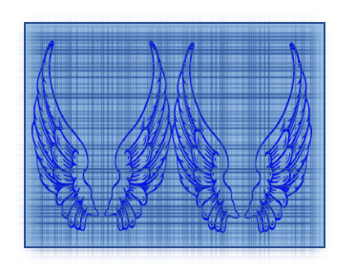
The Nature of Sin
(part two)
the gospel in the tabernacle: the shadow in the law of Moses
Ex 25:10-11, 21-22; the ark, the “throne” of God, where He would meet with them, speak with them [cp Gen 3:8; Rv 21:3-5]
The Holy Spirit was teaching something profound by means of this shadow…
Heb 9:8-10 !!!
Man sins: expelled toward the East?
The Holy of Holies
[Ex 26, 36]
The Holy Place
[Ex 26, 36]
Table for the showbread
[Ex 25:23-30]
The Ark
Altar of burnt offering
[Ex 27:1-8]
Altar of incense
[Ex 30:1-10]
“The way” to the tree of Life only possible via high priest! [Hb 9:1-7]
The gold lampstand
[Ex 25:31-40]
Bronze
laver
[Ex 30:17-21]
Adam and Eve sin, are cast out of God’s presence; God places cherubim at the east of Eden “to guard the way to the tree of Life” [Genesis 3:24]
the way back to the tree of life was restricted to the working of a high priest, who, after washings and offerings, would go from east to west into the veil
Genesis 3

Slide 28
The Nature of Sin
(part two)
the gospel in the tabernacle: the shadow in the law of Moses
Ex 25:10-11, 21-22; the ark, the “throne” of God, where He would meet with them, speak with them [cp Gen 3:8; Rv 21:3-5]
The Holy of Holies
[Ex 26, 36]
The Holy Place
[Ex 26, 36]
Table for the showbread
[Ex 25:23-30]
The Ark
Altar of burnt offering
[Ex 27:1-8]
Hebrews
4:14-16
Altar of incense
[Ex 30:1-10]
Jesus passed through the veil and is
the only “way” back to the throne
The gold lampstand
[Ex 25:31-40]
Bronze
laver
[Ex 30:17-21]
when Jesus died, the veil was torn in two (the cherubim removed!); “the way to the tree of Life” now is opened! [Mt 27:51; Hb 9:11-14; 10:19-22]
Eden and the tabernacle were only shadows of the true presence of God, seen in the “model” shown to Moses on the mountain [Rev 21:16; 22:1-5; cp Gn 2:9-10]
Genesis 3

Slide 29
The Nature of Sin
(part two)
the gospel in the tabernacle: the shadow in the law of Moses
Everything that was lost in sin
can be regained in Christ…
Romans 6:1-9
“baptized into His death” [Rm 6:3]
Prayer
The Holy of Holies
[Ex 26, 36]
The Holy Place
[Ex 26, 36]
Lord’s supper
The Ark
Access to the Father!
“walk in newness of life”
[Romans 6:4]
Walking
in the light
John 1:29
“If we died with Christ” [Rm 6:8]
Genesis 3

Slide 30
The Nature of Sin
(part two)
Jesus' words to a dying criminal offer hope to all who have sinned! There is still a hope of being in ‘Paradise’
[Lk 23:39-43; cp Rm 3:23!]
Do YOU wish to partake of that hope and the Tree of Life?
GOD EXTENDED HOPE TO THE MAN AND HIS WIFE!!
He did not destroy the tree, but only blocked the way for a while...
We find the Tree of Life again in the paradise of God, to which we have access by means of Jesus Christ (the "Seed" who was promised!)...
[see Exodus 26:1, 31-33; Mark 15:37-38; Hebrews 10:19-22; Rev 22:14]
Genesis 3

